Slide 1

Team Name: Celestialsapiens
Name of College(s)/University(s): Rajiv Gandhi Institute of Petroleum Technology, Jais
Team Members Details:
Nakshatra Joshi
Divyansh Parashar
Anshumaan Tanwar
Kunal Kumar

Slide 2

Detailed Solution
User Area Selection:
Interactive Map Interface: Users can start by selecting an area of interest on an interactive map or by entering the geographic coordinates of the desired location.
Building Footprint Extraction:
Deep Learning Integration: Utilizing a sophisticated Deep Learning model, the system processes satellite imagery of the selected area to accurately extract building footprints.
Rooftop Area Calculation: These extracted footprints are then analyzed to calculate the available rooftop area suitable for solar panel installation.
Solar Radiation Data Integration:
Regional Solar Radiation Data: The system integrates comprehensive solar radiation data specific to the region.
Efficiency and Sunlight Assumptions: Assumptions about solar panel efficiency and average sunlight hours are applied to provide a realistic estimate of potential solar energy generation.
Energy Generation Estimation:
Energy Production Calculation: By combining rooftop area data with solar radiation information, the system calculates the potential daily and yearly solar energy production for the selected area.
Dynamic Visualization:
Interactive Charts and Maps: The results are presented through dynamic charts and interactive maps, allowing users to visualize energy production over different time periods.
Map Display: The area of interest is highlighted on a map, providing a clear visual representation of the selected location and the corresponding energy estimates.
Comprehensive Reporting:
Detailed Insights: Users receive detailed reports that include the estimated rooftop area, potential energy production, and other relevant data, enabling informed decision-making.

Slide 3
Detailed Approach
Objective: Develop a geospatial web-based portal for estimating power generation from solar energy based on housing rooftops.
Detailed Roadmap:
Literature Survey:
Research ML/DL techniques (CNNs, U-Net, UNet-ASPP-Hybrid) for building extraction.
Reading research papers for building footprint extraction.(Citation:Article on building footprint extraction)
Data Collection:
Satellite Imagery: Obtain high-resolution imagery of North-Eastern region of India.
Solar Radiation Data: Source datasets from Nasa Power.
Building Footprint Extraction:
Model Training: Train with self-annotated datasets and satellite imagery..
Preprocessing: Enhance model with data augmentation.
Solar Energy Estimation:
Calculate rooftop areas from footprints.
Use Qgis and Rasterio to read the Geotiff files, and convert it into .csv files, for easier integration with the backend.
Estimate energy using solar radiation data, panel efficiency (15-20%), and sunlight hours. (Citation:https://www.pveducation.org/)
Web Portal Development:
Backend: Python (Django).
Geospatial Tools: QGIS for analysis and mapping.
Frontend: Intuitive and interactive UI with HTML, Tailwind CSS, Vanilla JavaScript.
Visualization:
Dynamic Charts & Maps: Display daily/monthly/yearly energy potential using Chart.js.

Slide 4
Tools and Technology Used
Frontend Development:
HTML: Structured the web pages, ensuring a solid foundation for displaying content.
Tailwind CSS: Styled the application with a utility-first approach, enabling responsive design and streamlined CSS management.
Vanilla JS: Added interactivity and dynamic behavior to the web interface, enhancing user experience.
Folium (Django Python Library): Created interactive maps for users to select areas of interest and visualize results.
Backend Development:
Django: Powered the backend with a robust, high-level web framework, handling data management, user authentication, and server-side logic efficiently.
Deep Learning Model:
NumPy: Conducted numerical computations and array manipulations essential for data preprocessing.
TensorFlow and Keras: Developed and trained deep learning models to extract building footprints from satellite imagery.
Matplotlib: Visualized model training progress and results, aiding in model evaluation and tuning.
Rasterio: Processed geospatial raster data, facilitating the extraction and analysis of rooftop areas from satellite images.
Solar Radiation Data Processing:
Rasterio: Managed and analyzed raster files containing solar radiation data, integrating this information to estimate solar energy potential.
QGIS: Used for visualizing and editing geospatial data, aiding in the accurate representation of solar radiation maps and ensuring data integrity.

Slide 5
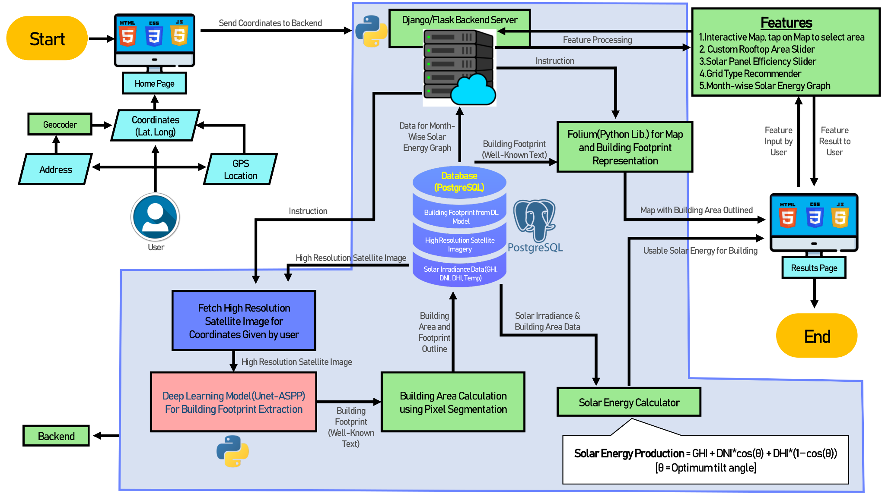
For Video Explanation
(Click here)
Proposed architecture/user diagram
Video Explanation of the architecture: https://www.youtube.com/watch?v=FepRD-0GMGg

Slide 6
How different is it from any of the other existing ideas?
Enhanced Accuracy:
Multi-Parameter Analysis: Utilizes multiple parameters affecting total solar radiation output, ensuring higher accuracy in energy estimation.
DGPS: Differential GPS usage for accurate house judgement to avoid confusion between adjacent houses
Comprehensive Information:
User-Centric Data: Provides additional useful information, such as the number of appliances supported, tailored to everyday users.
Intuitive User Interface:
Non-Technical Accessibility: Designed for ease of use, making it accessible for non-technical users with a straightforward and informative interface.
Advanced Features:
Off-Grid and On-Grid Options: Offers recommendations based on user-specific electricity consumption patterns.
Optimal Solar Panel Selection: Advises on the most suitable solar panel types and outputs, accounting for future energy needs.
Future Expansion Planning: Includes considerations for scalability to accommodate increasing energy demands.

Slide 7
How will it be able to solve the problem?
Satellite Data Utilization: Our solution leverages satellite data to estimate the potential solar energy generation for rooftops accurately.
Personalized Recommendations: Users receive precise information on the amount of solar energy they can generate and the optimal rooftop area needed to meet their daily electricity requirements.
Environmental Benefits: By promoting the use of sustainable and renewable energy sources, our solution helps governments reduce pollution.
Comprehensive User Interface: Beyond solar energy estimation, our interface offers a wealth of information and guidance, becoming an end-to-end resource for solar panels.
Solar Panel Installation: Step-by-step instructions for installing solar panels.
System Recommendations: Tailored advice on the best solar panel systems based on user-specific needs.
Cost-Benefit Analysis: Detailed financial analysis, including potential savings and return on investment.
Maintenance Tips: Guidelines for maintaining solar panels to ensure long-term efficiency.
Future Expansion Planning: Advice on scaling the system for future energy needs.
Decision-Making Support: The platform can assist users in deciding between off-grid and on-grid systems based on their electricity consumption patterns.
Optimized Solar Panel Selection: Recommendations for the most suitable type and output of solar panels, considering current and future energy requirements.

Slide 8
USP of the proposed solution.
Advanced Technology Integration:
Satellite Image Analysis: Employs state-of-the-art satellite imagery and data analytics to accurately estimate solar energy potential.
Precision Energy Estimation: Utilizes multiple parameters for highly accurate solar energy output predictions.
User-Friendly Interface:
Intuitive Design: Accessible and easy-to-navigate interface for both technical and non-technical users.
Comprehensive Information: Provides detailed and actionable insights to inform user decisions.
End-to-End Solution:
Installation Guidance: Detailed, step-by-step instructions for seamless solar panel setup.
Tailored System Recommendations: Custom advice based on user-specific needs and energy consumption.
Financial Analysis Tools: Calculates potential savings, ROI, and payback periods.
Maintenance Guidelines: Best practices for optimal panel performance and longevity.
Scalability Planning: Supports future expansion and energy needs assessment.
Decision-Making Support:
Off-Grid vs. On-Grid Analysis: Informed recommendations based on consumption patterns.
Optimal Panel Selection: Advises on the best solar panel types and outputs for current and future requirements.
Environmental Impact:
Sustainable Energy Adoption: Encourages renewable energy use, reducing pollution and greenhouse gas emissions.
Policy Alignment: Supports government initiatives for sustainable energy adoption.

Slide 9
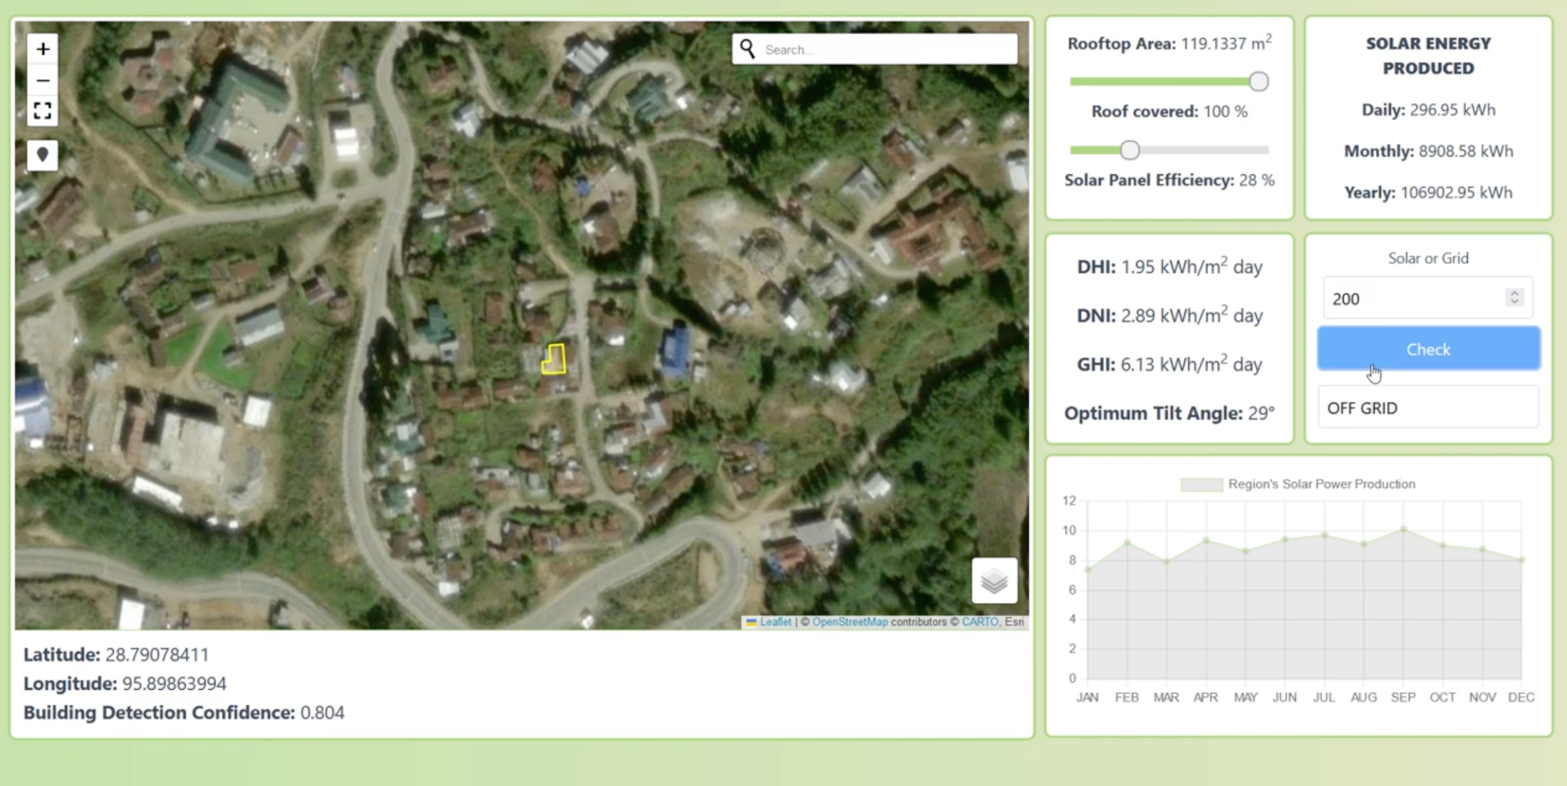
Prototype Video
Video Link
Video Link: https://youtu.be/M9qOAxuIxNg

Slide 10
List of features offered by the solution
Cost-Benefit Analysis and Financial Insights:
Savings and ROI: Estimates cost savings and return on investment (ROI) for solar panel installations.
Financial Tools: Includes calculators for payback periods and long-term financial benefits.
Personalized Recommendations and System Configurations:
Grid-Type Advice: Suggests off-grid or on-grid systems based on electricity consumption.
Custom Configurations: Allows users to select and adjust solar panel configurations, showing the impact on output and costs.
Energy Storage and Battery Benefits:
Storage Options: Estimates the advantages of adding energy storage systems, like batteries.
Reliability Enhancements: Provides insights into improved energy reliability and potential savings with storage.
Policy Information and Government Incentives:
Local Subsidies: Displays relevant local policies, subsidies, and incentives for solar energy adoption.
Resource Links: Provides access to government websites, such as the PM Surya Ghar initiative.
Marketplace and Purchasing Assistance:
Price Comparisons: Recommends and compares prices for solar panels to help users find the best deals.
Marketplace Links: Connects users to trusted vendors for purchasing solar equipment.
Detailed Energy Production Visualizations:
Dynamic Charts and Maps: Displays energy production through interactive charts and maps.
Custom Area Display: Highlights the selected area of interest on a map, providing a clear visual representation.
Accurate Rooftop Mapping with DGPS:
Precision Mapping: Utilizes Differential GPS (DGPS) technology for accurate rooftop area calculations, reducing confusion between adjacent houses

Slide 11
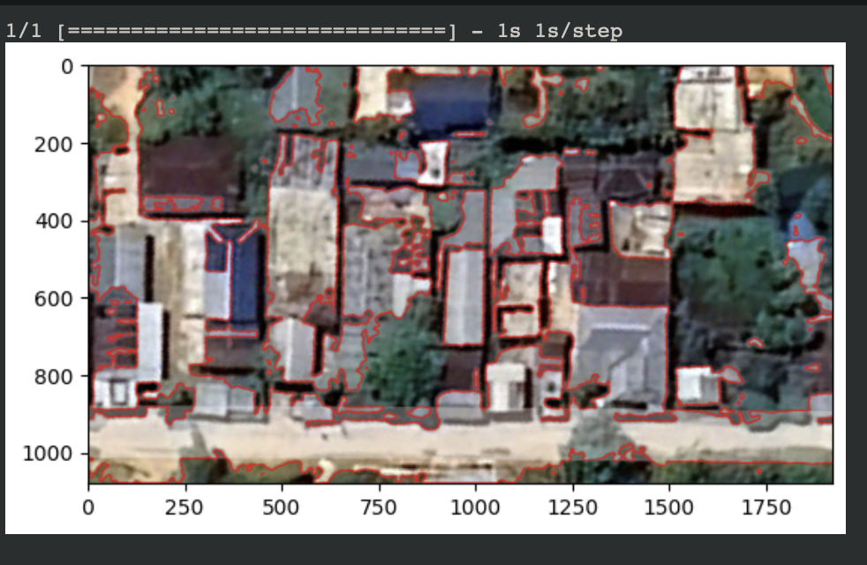
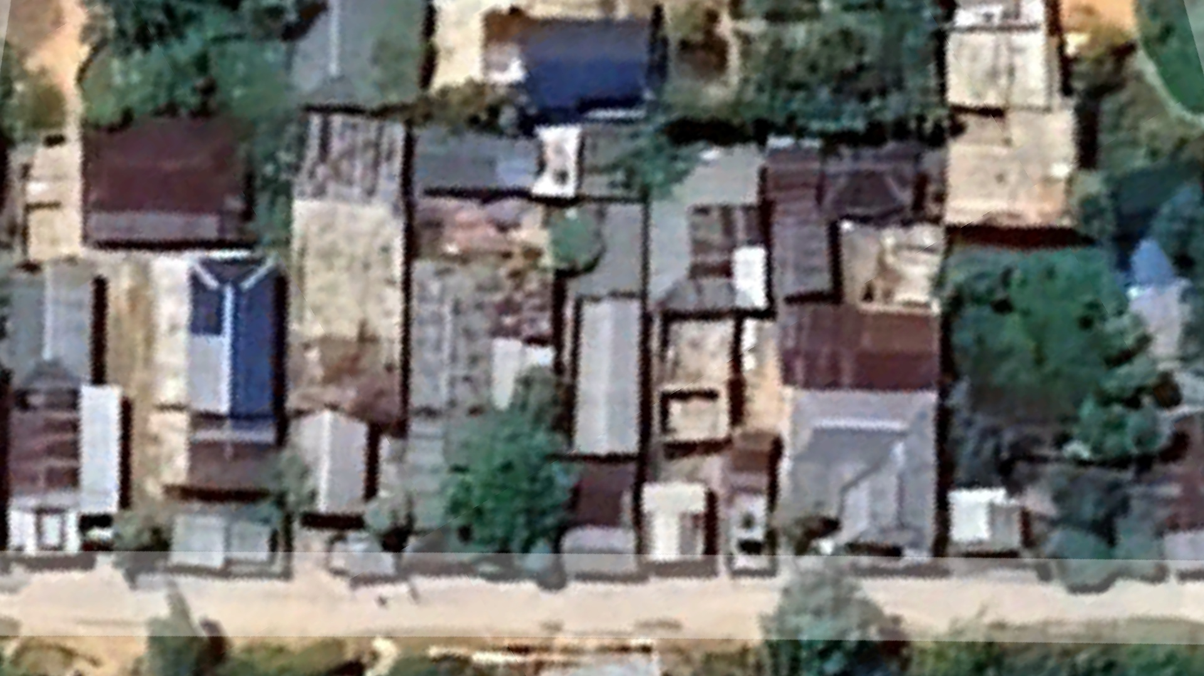
UNET-ASPP-Hybrid Deep Learning Model
Model Google Colab Notebook Link

Slide 12
Solution Brief (Overall)
Our solution offers a cutting-edge geospatial web-based portal designed to estimate solar energy potential from rooftops using deep learning and satellite imagery. By allowing users to select specific areas, either on an interactive map, or by coordinates, the system extracts building footprints and calculates rooftop areas accurately. We utilize advanced deep learning models such as CNNs and U-Net, combined with high-resolution satellite images, to ensure precise extraction and measurement. The system integrates regional solar radiation data, enabling it to provide reliable estimates of daily and yearly solar energy production. This comprehensive approach ensures users receive accurate insights into the potential solar energy their rooftops can generate.
The user-friendly interface of our portal simplifies the process for non-technical users, offering detailed reports, interactive visualizations, and personalized recommendations for solar panel installation. Dynamic charts and maps display energy production estimates, facilitating easy interpretation and planning. Additionally, the platform provides tailored advice based on individual energy consumption patterns, suggesting optimal grid types and potential savings. By promoting sustainable energy adoption and supporting informed decision-making, our solution empowers users to contribute to a greener future while maximizing the benefits of solar energy. This innovative approach not only aids in reducing carbon footprints but also enhances energy efficiency and cost savings for households and businesses alike.

Slide 13


